Slide 1

The Unseen Gateway: Understanding Proxy Servers
Presented by Md Sadman Kabir
ID-2102020
Date-22/11/25
Notes:
Hello everyone,my name is sadman Kabir.id 2102020
Todays topic is understanding proxy servers

Slide 2
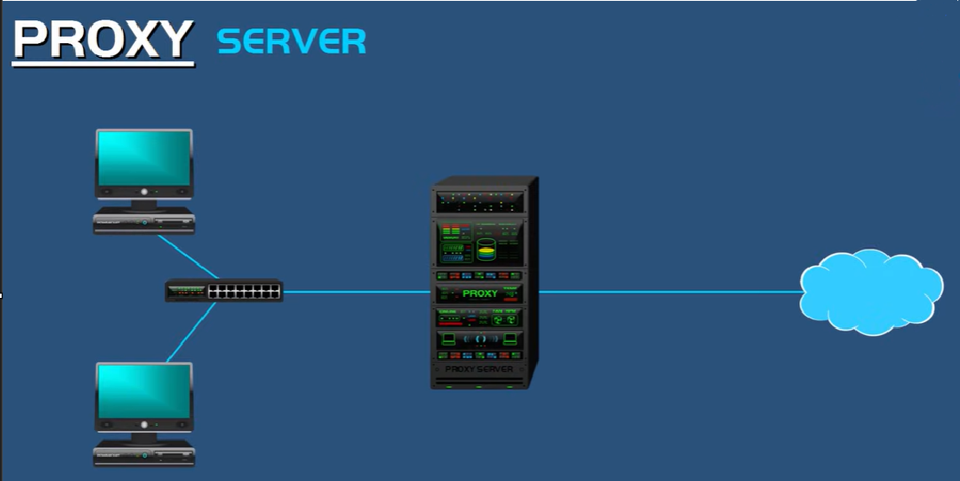




What Exactly is a Proxy Server?
At its core, a proxy server acts as an intermediary or a "middleman" between your computer (the client) and the websites or services
you access on the internet.
Client Request
Proxy Middleman
Web Server
Response Flow
Notes:
A proxy server is a computer or service that sits between a user and the internet. When you open a website using a proxy, your request does not go directly to the website. Instead, the request first goes to the proxy server. The proxy then forwards your request to the actual website, receives the website’s response, and finally sends it back to you.
Because the proxy stands in the middle of the communication, it is often called a middleman. It receives your request, passes it on, and returns the response—acting like a messenger between you and the website.
This “middleman” behavior also allows a proxy server to provide benefits such as privacy, filtering, security, and sometimes faster performance through caching.

Slide 3


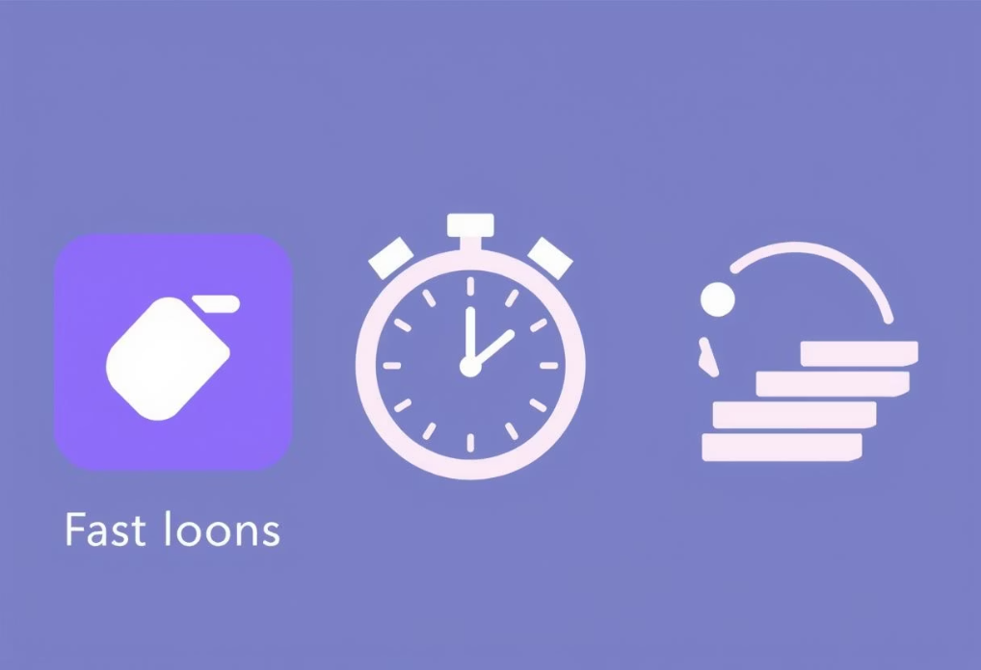
Key Advantages of Using a Proxy Server
Proxy servers offer compelling benefits that enhance your online experience and network management.
1
2
3
Enhanced Privacy
Improved Speed & Efficiency
Granular Control
Your true IP address is masked. The website you visit only sees the proxy's IP, offering a layer of anonymity for your browsing activities.
Proxies use caching to store copies of frequently accessed web pages. If you (or someone else on the network) requests the same page again, the proxy can serve it instantly, reducing load times and bandwidth usage.
Network administrators can use proxies to monitor internet usage, filter content, and block access to specific websites, essential for corporate or educational environments.
Notes:
1. Privacy A proxy server hides your real IP address. When you visit a website, the site sees the proxy’s IP instead of yours. This helps protect your identity and keeps your online activities more private.
2. Speed Proxies can store copies of frequently visited websites. So when a user requests the same site again, the proxy can deliver it faster without loading everything from the internet each time.
3. Saves Bandwidth Because the proxy can cache web pages, images, and data, it reduces the amount of data downloaded from the internet. This helps save bandwidth, especially in networks with many users.
4. Activity Logging Proxies can monitor and log user activity. This is useful for schools, offices, and organizations that want to track browsing behavior, block certain sites, or maintain security and compliance.

Slide 4
The Limitations of Proxy Servers
While beneficial, it's crucial to understand that proxy servers are not a complete security solution.
A significant limitation is that most proxy servers do not encrypt your data.
This means that while your IP address might be hidden, the actual data you send and receive over the internet could still be intercepted and read by malicious actors. For sensitive information, additional security measures are necessary.
Notes:
1. Limited Security A proxy can hide your IP address, but it does not fully secure your data. It does not encrypt your traffic like a VPN, so sensitive information can still be exposed.
2. No Protection Against Malware Most basic proxy servers cannot detect or block viruses, malicious websites, or harmful downloads. Users may still be at risk if they access unsafe pages.
3. Performance Issues If many users connect at the same time, the proxy server can become overloaded. This may slow down the internet instead of speeding it up.
4. Caching Problems Proxies use cached pages to increase speed, but sometimes the cached version is outdated. Users may not always get the most recent information.
5. Privacy Concerns Since the proxy sits in the middle, it can log all user activity. If the proxy is not trustworthy, it can misuse or leak user data.

Slide 5












The Journey of a Web Request Through a Proxy
Let's break down the simple, yet effective, process of how a proxy server handles your internet requests.
1. User Initiates Request
You type a website URL into your browser.
2. Request to Proxy
This request is first sent to the configured proxy server.
3. Proxy Fetches Content
The proxy server then requests the page from the internet (web server).
4. Content Delivered
The web page is sent back to the proxy, which then delivers it to your browser.

Slide 6
Proxy Server vs. VPN: Understanding the Difference
It's common to confuse proxy servers with Virtual Private Networks (VPNs). While both can offer anonymity, their functionalities differ significantly.
IP Masking
Yes
Yes
Data Encryption
No
Yes
Security Level
Low to Medium
High
Best Use Case
Bypassing geo-restrictions, caching
Sensitive data, strong privacy
For truly secure and private browsing, especially with sensitive data, a VPN is the superior choice due to its robust encryption capabilities.

Slide 7


A Glimpse into a Simple Python Proxy Server
Let's look at the core logic behind a basic proxy server, exemplified by a simplified Python implementation. While we won't dive into the full code,
understanding the main steps illuminates its operation.
The proxy listens on a specific address and port (e.g., 127.0.0.1:8888).
It receives client requests for web pages.
It then connects to the target web server (e.g., example.com).
Finally, it sends the server's response back to the client.

Slide 8
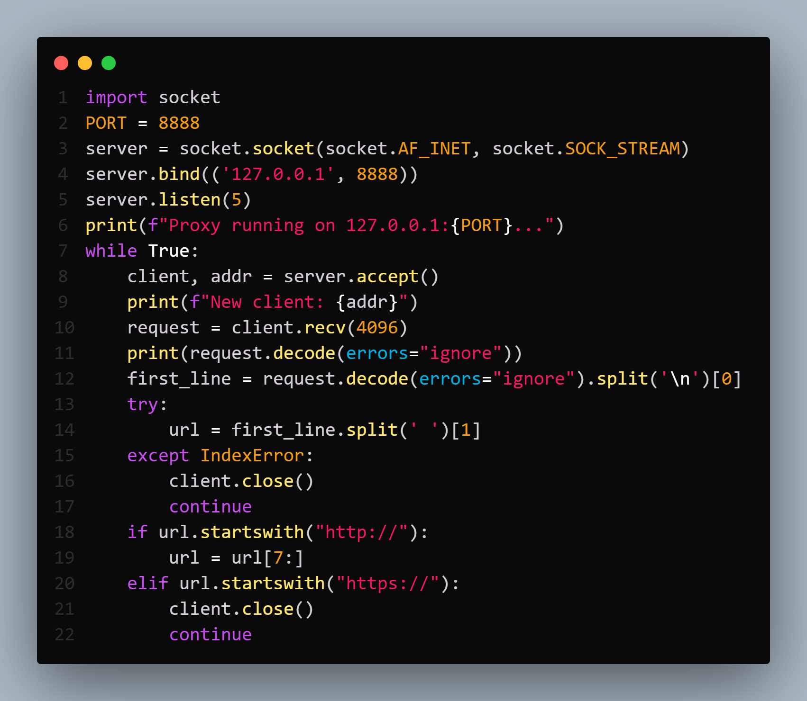
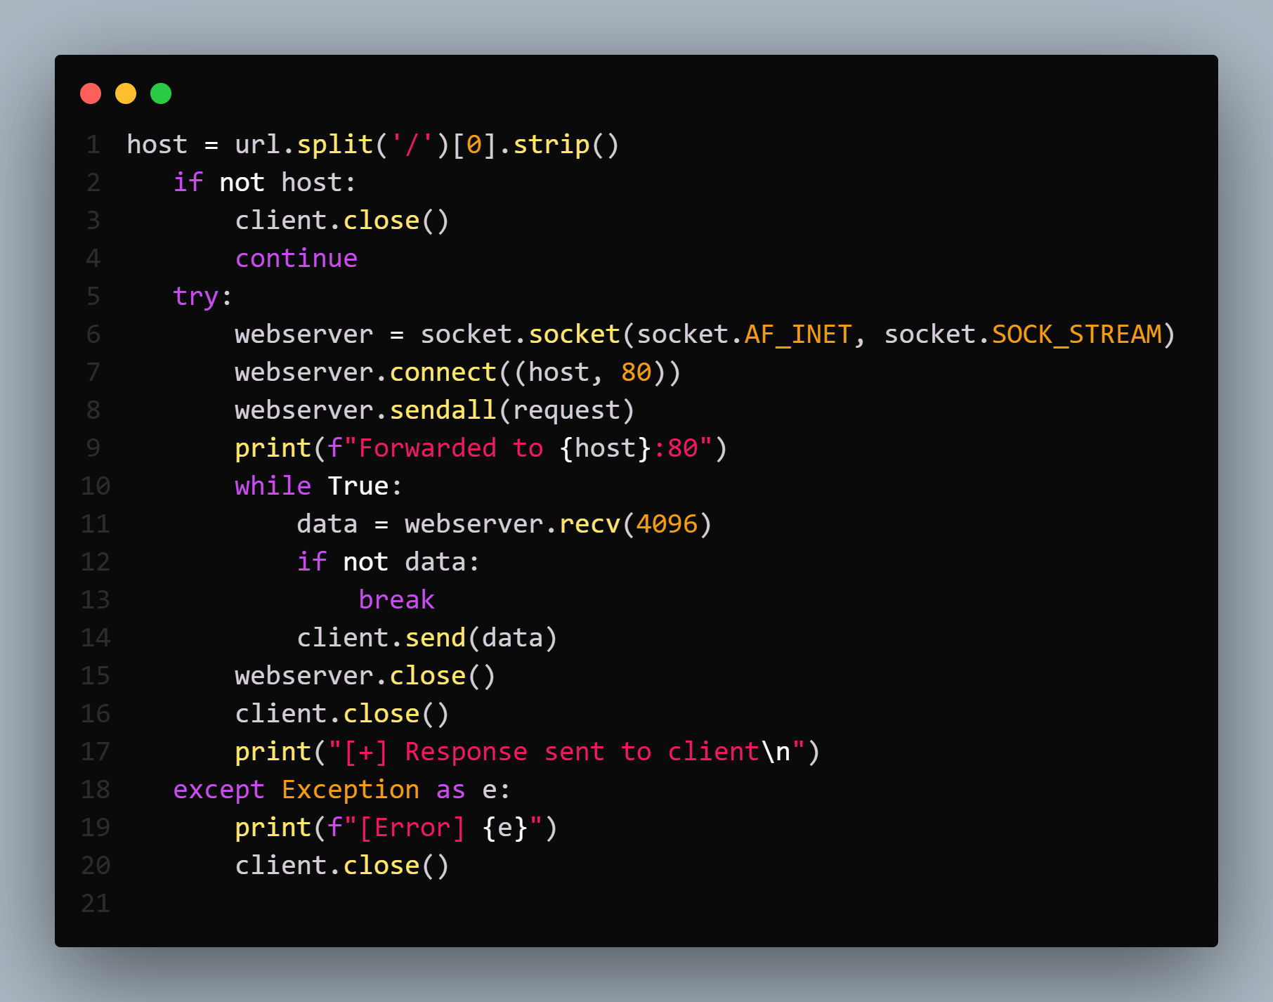
Code Explanation

Slide 9
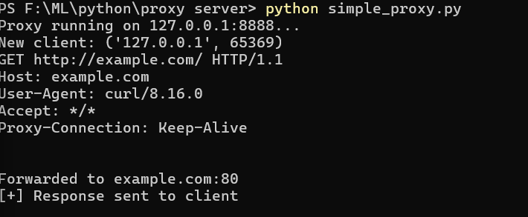
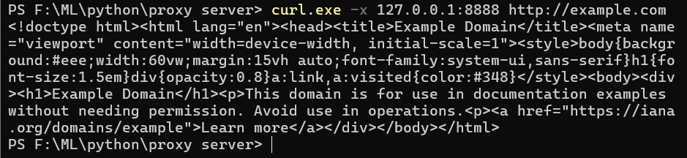
Output

Slide 10




Practical Applications of Proxy Servers
Proxy servers are not just theoretical concepts; they are widely used in various real-world scenarios to enhance network performance, security, and management.
Corporate Internet Control
Businesses use proxies to enforce internet usage policies, block inappropriate content, and monitor employee browsing for productivity and security.
Educational Network Management
Schools and universities implement proxies to filter content, manage bandwidth, and protect students from harmful online material.
Privacy-Conscious Browsing
Individuals use proxies to hide their IP addresses, bypass geo-restrictions, and enhance their anonymity online.
Speed Optimization
Through caching, proxies significantly speed up access to frequently visited websites, improving user experience and reducing network traffic.

